Slide 1
4 Types of Scrum Ceremonies
-by B.Manikarthik
P.Kavitha
D.Pratyusha
J.Gaurav

Slide 2
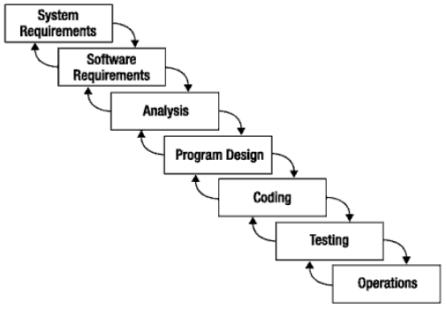
What is Scrum?
Is an agile, lightweight process
Can manage and control software and product development
Uses iterative, incremental practices
Has a simple implementation
Increases productivity
Reduces time to benefits
Embraces adaptive, empirical systems development
Is not restricted to software development projects
Embraces the opposite of the waterfall approach…

Slide 3
Scrum Ceremonies:
Meetings or "ceremonies" are an important part of agile development.
They help to broadcast information to all team member, Bring common goal and vision, Share team progress appropriately.

Slide 4
Types of ceremonies:
Sprint Planning
Daily Stand-up
Iteration review
Retrospective

Slide 5




Sprint Planning Mtg.
Team capacity
Sprint planning meeting
Sprint prioritization
Sprint
goal
Product backlog
Analyze/evaluate product backlog
Select sprint goal
Business conditions
Sprint planning
Decide how to achieve sprint goal (design)
Create sprint backlog (tasks) from product backlog items (user stories / features)
Estimate sprint backlog in hours
Current product
Sprint
backlog
Technology

Slide 6
Why sprint planning is important?
The idea behind the sprint planning is to provide understanding between development and the customer when something new will be available, and to define the length of the feedback loop, which is equals to the length of the sprint.
In other words, the customer will know that He/she will get something in 2 weeks, which works, and the development team will know that they'll receive feedback on their work and know more about the upcoming work in two weeks. That's predictability.

